Slide 1
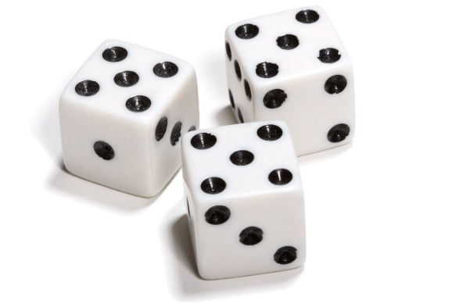

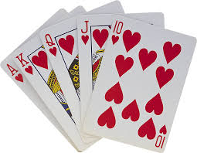
My Probability Interactive Notebook
Name
Class
Teacher
Term 4 Semester 2
1

Slide 2
Theoretical Vs Experimental Probability
Theoretical: What should happen
Experimental: What did happen

Slide 3
Which hybrid creature are you?
You are about to become a mythical hybrid creature (eg; half human, half fish is a mermaid/merman)
To find out which one you’ll become you need to;
Roll the dice once to see what your body will be
- Even: Horse
- Odd: Lion
Roll the dice a second time to see what head you will get
- Even: Human
- Odd: Eagle
And this is what you’ll become…

Slide 4
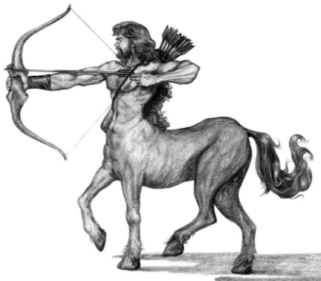
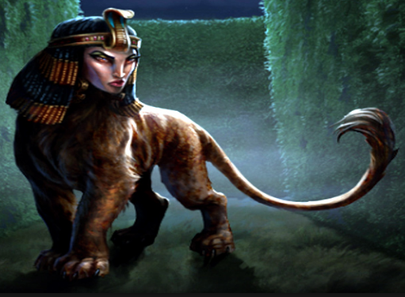
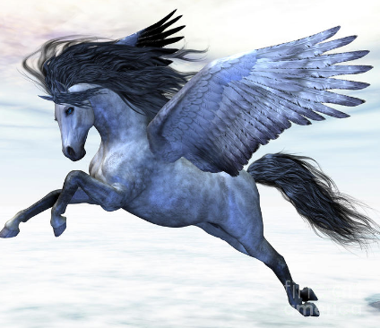
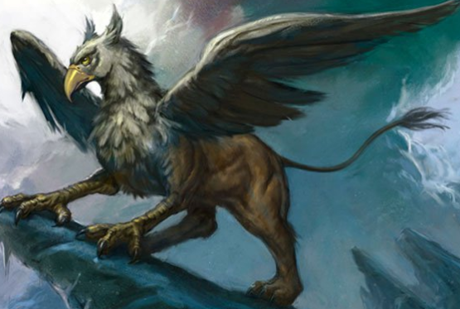
Which hybrid creature are you?
 |  | Body (Dice 1)
 |  | Horse (Even) | Lion (Odd)
Head (Dice 2) | Human (Even)
 | Eagle (Odd)

Slide 5
Theoretical Vs Experimental Probability
Why is the experimental probability different to the theoretical probability?
What can we do to get these numbers closer together?

